Slide 1
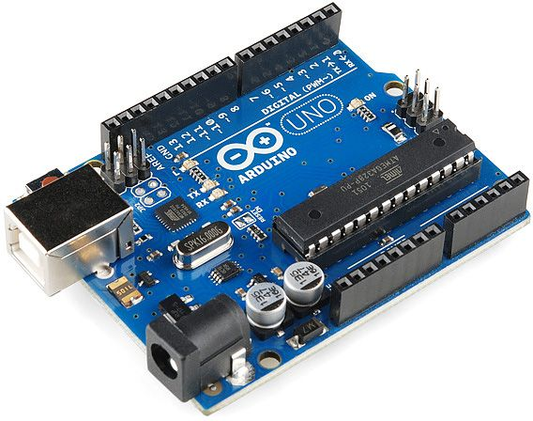
ARDUINO
BY: Excess Nepal

Slide 2

What is Arduino??

Slide 3
Arduino is an open-source
Flexible electronics prototyping platform
easy-to-use hardware and software.
Intended for artists, designers, hobbyists, and anyone interested in creating interactive objects or environments.

Slide 4
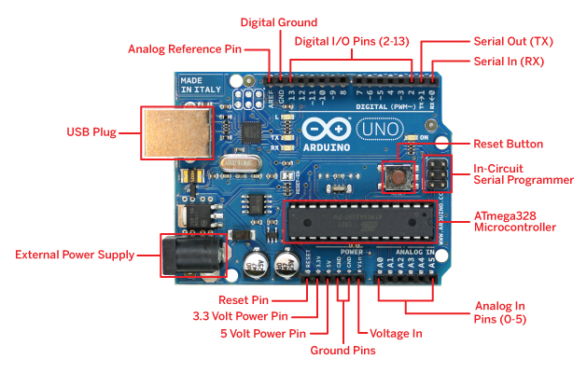
2.0 HARWARE OVERVIEW

Slide 5
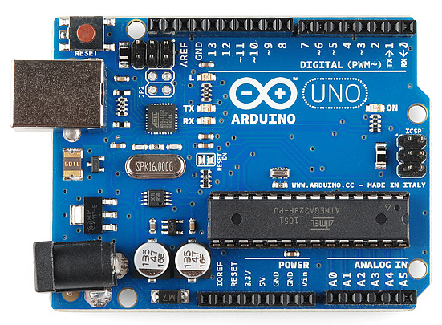
DIGITAL PINS
Digital Pin (0-13)
State: HIGH or LOW i.e 1 or 0
Use as Digital Input and Output
pinMode (PIN,MODE)
PIN: 0-13
Mode : INPUT / OUTPUT

Slide 6
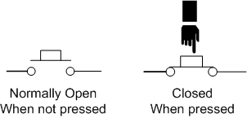
DIGITAL PINS AS INPUT
Read the value from specified pin
Either HIGH or LOW
Pin can be specified as either a variable or constant(0-13)
digitalWrite(Pin,HIGH);

Slide 7
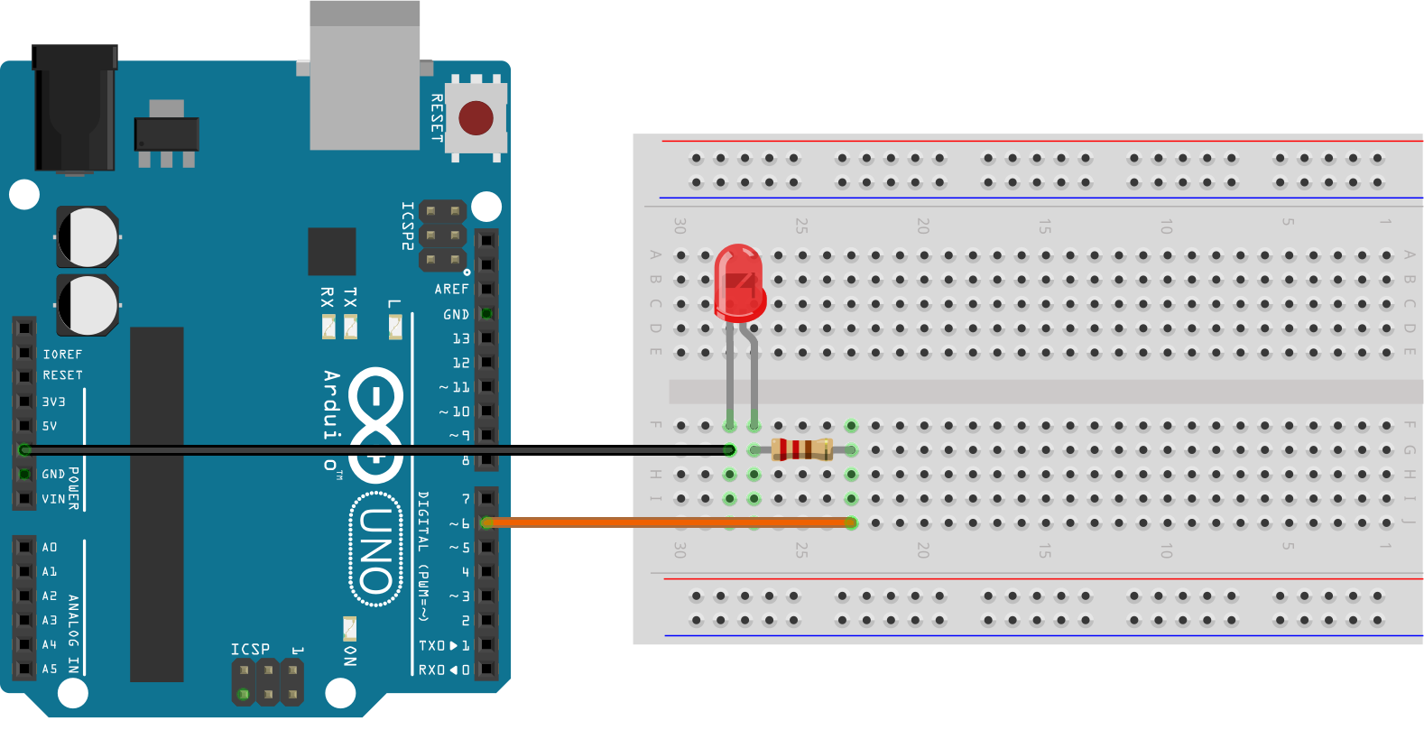
DIGITAL PINS AS OUTPUT
Write the value to specified pin
Either HIGH or LOW
Pin can be specified as either a variable or constant(0-13)
digitalWrite (pin, HIGH);

Slide 8
ANALOG PINS READ
Analog pin (0-5)
Read the analog value from specified pin
Resulting integer value 0 to 1023
Do not need to first declared as INPUT OR OUTPUT
analogRead(PIN);

Slide 9
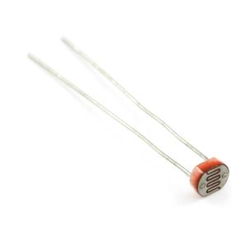
ANALOG PINS WRITE
analogWrite(PIN,VALUE)
using hardware enabled pulse width modulation(PWM)
This function works on the pin 3 , 5 , 6 , 9 and 11

Slide 10
Download and installation Arduino IDE
Arduino IDE software download from the official site of Arduino
The site is arduino.cc

Slide 11
Programming Syntax
// - Single line comment
/* */ - Multiline comment
{ } – used to define a block of code that starts and ends.
; - used to define the end of a line of code.

Slide 12
PROGRAMMING - VARIABLES
= (assignment) For example, x = 10*2, thus x = 20.
% (modulo) – this gives the remainder when one number is divided by another. For example 12 % 10 gives 2.
+ (addition)
- (subtraction)
* (multiplication)
/ (division)

Slide 13
COMPARISON OPERATORS
== (equal to) - For example 12==10 is FALSE and 12 ==12 is TRUE.
!= (not equal to) - For example 12!=10 is TRUE and 12!=12 is FALSE.
< (less than)
> (greater than)

Slide 14
PROGRAMMING - CONTROL STRUCTURE
if(condition) { }
else if (condition) { }
else(condition) { }
This will execute the code between the curly braces if the condition is true, and if not test the condition of the “else if”. If that is false , the “else” code will execute.
for (int i =0; i < #repeats; i ++) { }
Used when you would like to repeat a line of code a specific # of times. Often called a FOR LOOP.

Slide 15
SUMMARY TO ARDUINO UNO
Microcontrollers AT mega 328
Operating Voltage 5V
Digital I/O Pins 14 (of which 6 provide PWM output)
Analog Input Pins 6
DC Current per I/O Pin 40 mA
Flash Memory 32 KB (of which 0.5 KB used by bootloader)
SRAM 2 KB (ATmega328)
Clock Speed 16 MHz

Slide 16
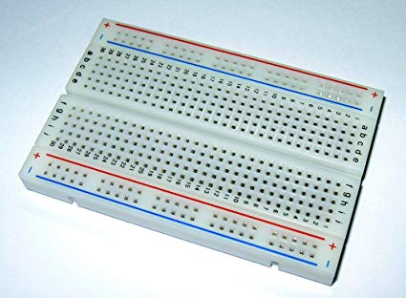
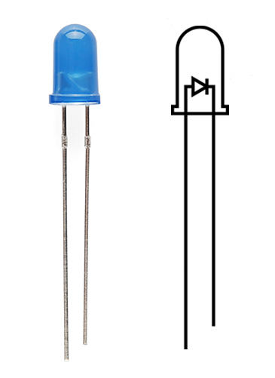
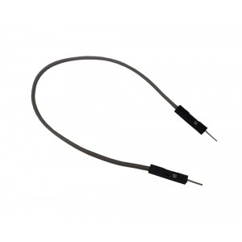
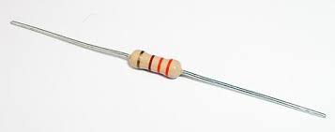
LED BLINKING
Component required:
Arduino UNO R3
LED
Jumper wires
Breadboard
330 ohm resistor

Slide 17
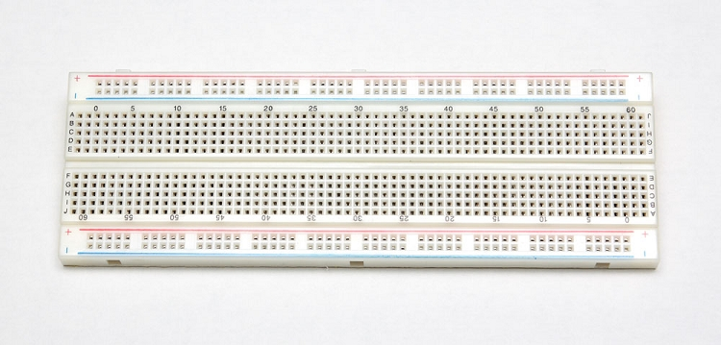
breadboard
A breadboard is a construction base for prototyping of electronics
A test platform for developing electronic devices.

Slide 18
Breadboard contd….
A-B-C-D same terminal
4 pair of horizontal power supply terminals

Slide 19
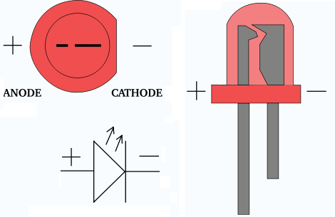
LED
Emits light when a small current passes through it
It only works in ONE
direction. So make sure you
attach it correctly. Also it
often needs a resistor to
limit the current going to it.
Schematic Symbol
Longer Led is Positive

Slide 20
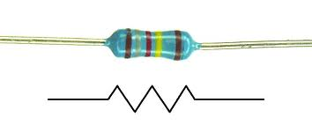
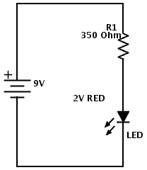
Appropriate resister
Restrict / limit the amount of electrical current
Protect LED from burn
Schematic Symbol

Slide 21
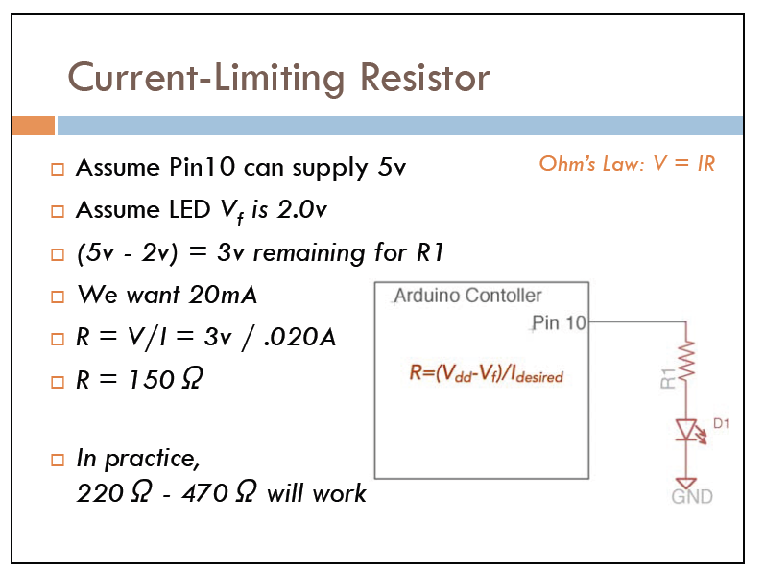
Selection of Resistor

Slide 22

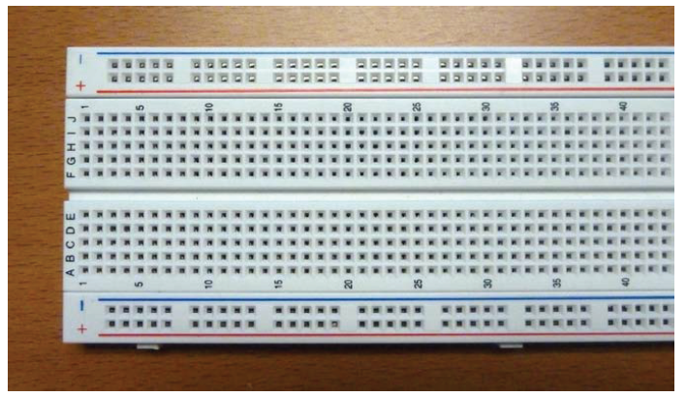
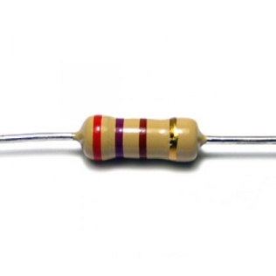
Connection Diagram

Slide 23

Its coding time……

Slide 24
Program explanation
void setup ( ) { } - All of the code within the curly braces will be run ONCE when the program first runs.
void loop ( ) { } - This function is run AFTER setup has finished. All of the code within the curly braces will be run again, and again, until the power is removed.

Slide 25
Thank you

